Slide 1


Accounts Payables Operations and Reporting in Oracle ERP Project
Prepared By /
Ahmed Mabrouk Fawzy Abdullah

Slide 2
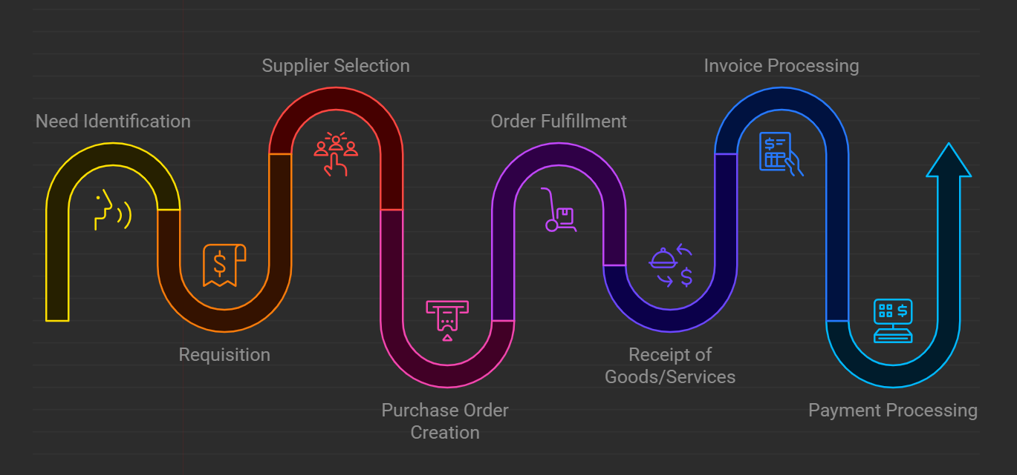
Procure to Pay Cycle (P2P)

Slide 3
Accounts Payables Operations and Reporting in Oracle ERP Project
Definition: The process of creating, managing, and adjusting supplier invoices in the Accounts Payable module, ensuring accurate billing and tracking of outstanding amounts.
Key Tasks:
a. Create and Manage Supplier Invoices:
b. Learn how to create manual supplier invoices:

Slide 4
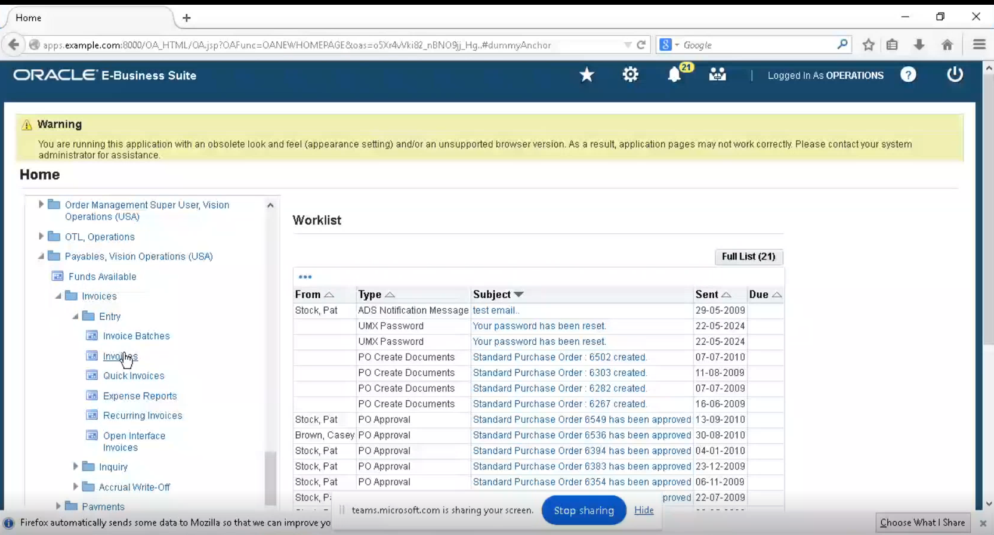
Navigate to Payables → Invoices → Entry.
Access the invoice section within the Accounts Payable module.

Slide 5
1. Standard Invoice

Slide 6
In the "Type" field, select Standard Invoice.
Select the "Standard Invoice" type.
Enter the Invoice Date and select the Supplier.
Input the invoice date and choose the supplier from the list.
Select the Invoice Currency.
Choose the currency for the invoice.
Enter the Invoice Number and Amount.
Input the invoice number and the total amount.
Click on the "Lines" section to enter item/service details (description, quantity, unit price).
Click on the "Lines" section to enter details of the goods or services (description, quantity, unit price).
Review the invoice for accuracy and click Validate.
Review the invoice for accuracy and click "Validate" to ensure correctness.
To post the accounting entry, navigate to Actions → Create Accounting.
To create the accounting entry, go to "Actions" and select "Create Accounting."

Slide 7
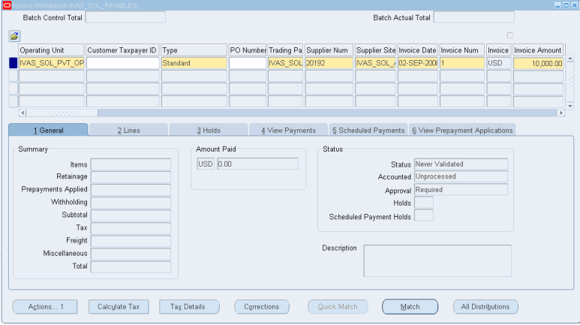
Click on Match tab

Slide 8
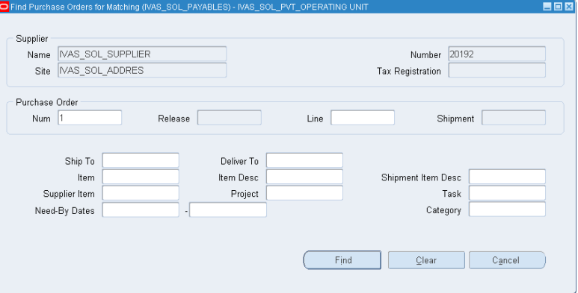
Enter Purchase Order Num
Click on Find

Slide 9
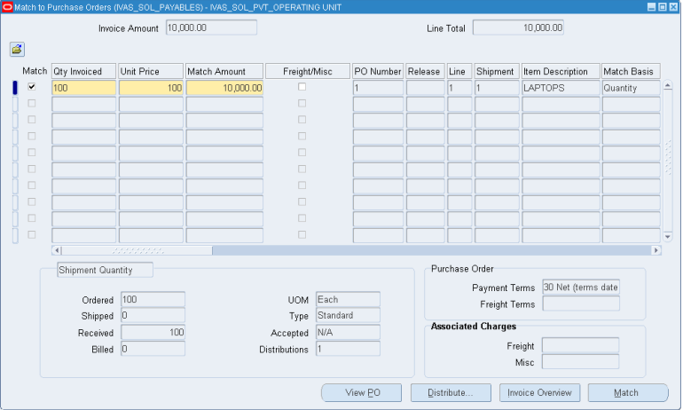
Enable Match
Click on Match button

Slide 10
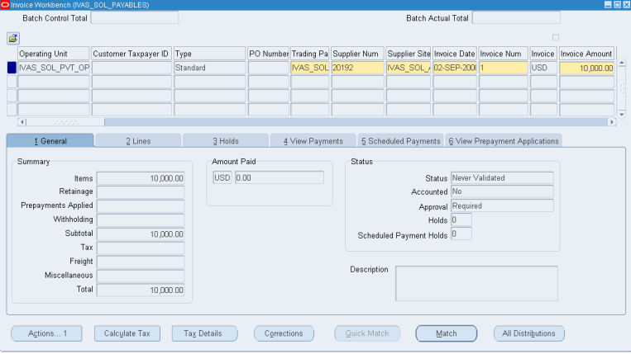
Now the Invoice is been matched
We can see the status is (Never Validated)

Slide 11
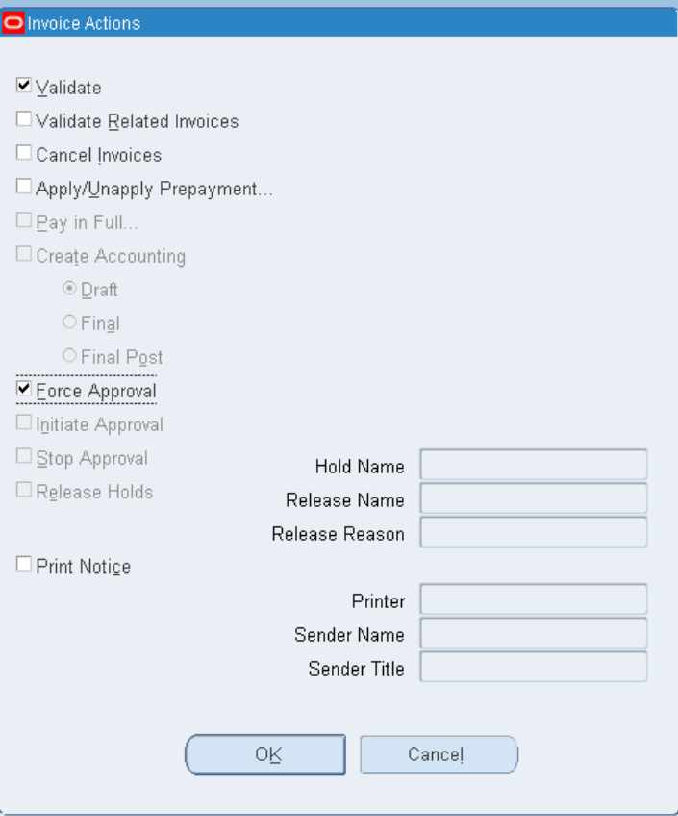
Click on Actions tab for Validate and Force Approval

Slide 12
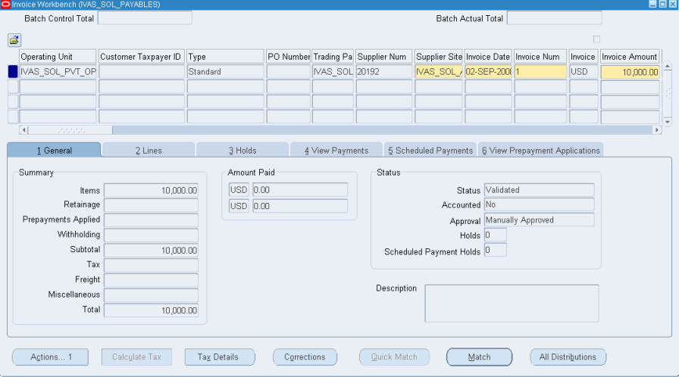
See the changes in Status:
Status as Validated and Approval as Manually Approved

Slide 13
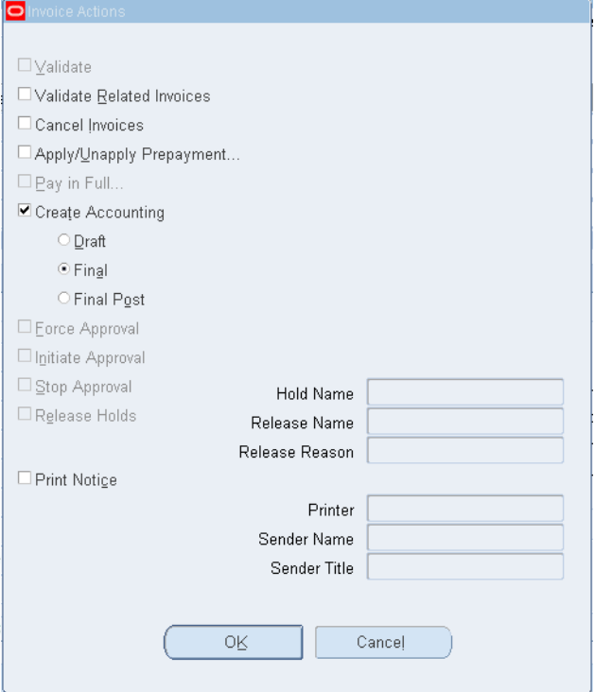
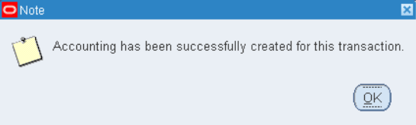
Click on Actions tab for creating accounting

Slide 14
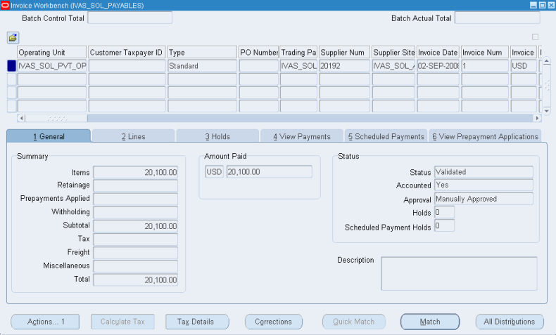
See the changes in Status Accounted as YES

Slide 15
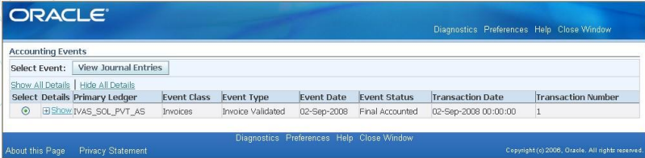
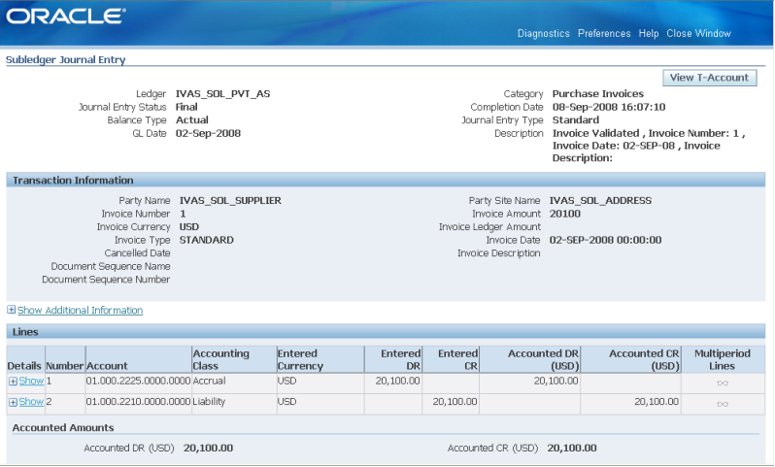
To see the transactions that happened
N: Tools >View Accounting Events
Click on View Journal Entries tab

Slide 16
2. Credit Memo

Slide 17
In the "Type" field, select Standard Invoice.
Select the “Credit Memo Invoice" type.
Enter the Invoice Date and select the Supplier.
Input the invoice date and choose the supplier from the list.
Select the Invoice Currency.
Choose the currency for the invoice.
Enter the Invoice Number and Amount (with negative value).
Input the invoice number and the total amount.
Click on the "Lines" section to enter item/service details (description, quantity, unit price).
Click on the "Lines" section to enter details of the goods or services (description, quantity, unit price).
Review the invoice for accuracy and click Validate.
Review the invoice for accuracy and click "Validate" to ensure correctness.
To post the accounting entry, navigate to Actions → Create Accounting.
To create the accounting entry, go to "Actions" and select "Create Accounting."

Slide 18
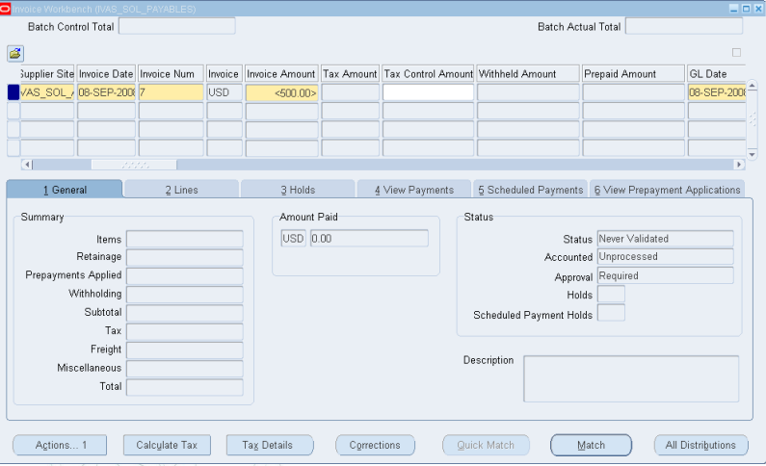
Save your work
Click on match button to match the goods returned

Slide 19
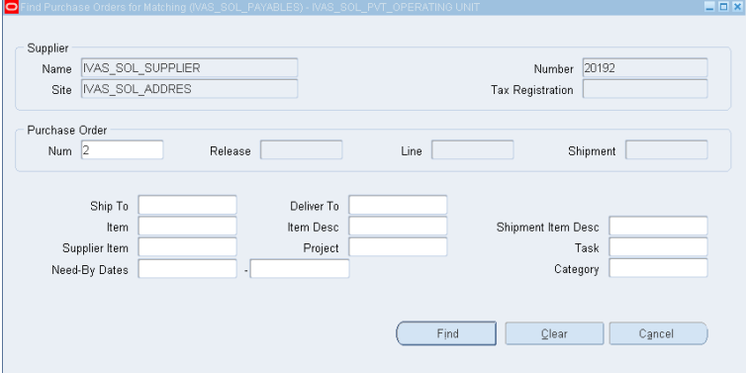
Select the purchase order number for which goods are returned
Click on Find

Slide 20
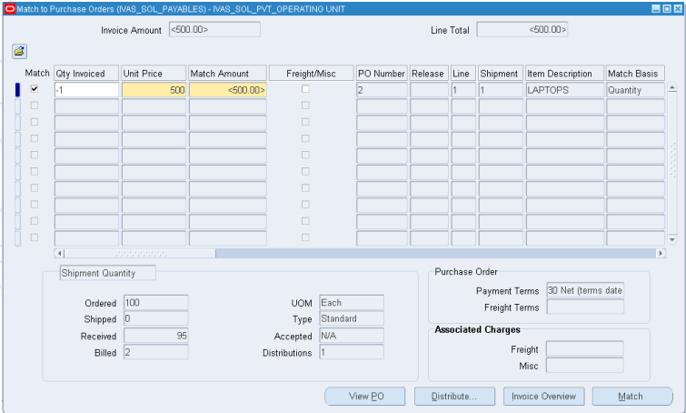
Enable match option and enter the Quantity invoiced in negative
Click on Match button

Slide 21
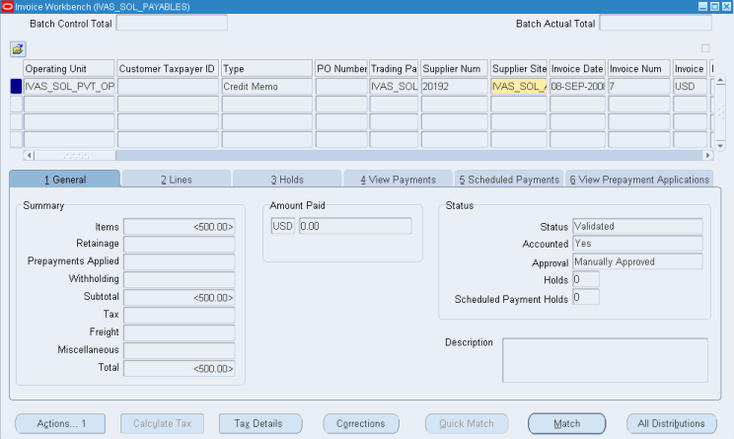
Now the Invoice is been matched
Click on Actions tab for Validate and Force Approval
See the changes in Status:
Status as Validated and
Approval as Manually Approved

Slide 22
3. Debit Memo

Slide 23
In the "Type" field, select Standard Invoice.
Select the “Debit Memo Invoice" type.
Enter the Invoice Date and select the Supplier.
Input the invoice date and choose the supplier from the list.
Select the Invoice Currency.
Choose the currency for the invoice.
Enter the Invoice Number and Amount (with negative value).
Input the invoice number and the total amount.
Click on the "Lines" section to enter item/service details (description, quantity, unit price).
Click on the "Lines" section to enter details of the goods or services (description, quantity, unit price).
Review the invoice for accuracy and click Validate.
Review the invoice for accuracy and click "Validate" to ensure correctness.
To post the accounting entry, navigate to Actions → Create Accounting.
To create the accounting entry, go to "Actions" and select "Create Accounting."

Slide 24
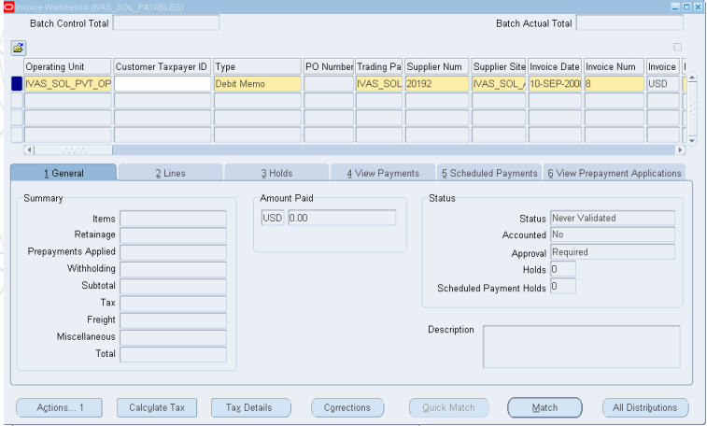

Slide 25
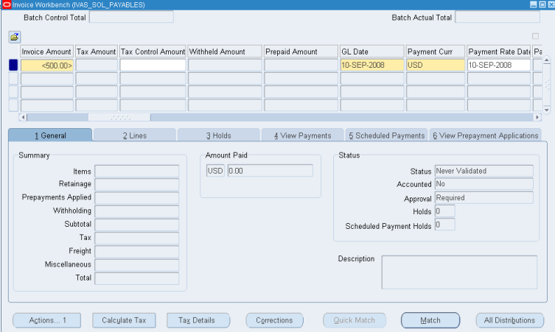
Enter the amount with Negative invoice amount and
payment terms
Save your work
Click on match button to match the goods returned

Slide 26
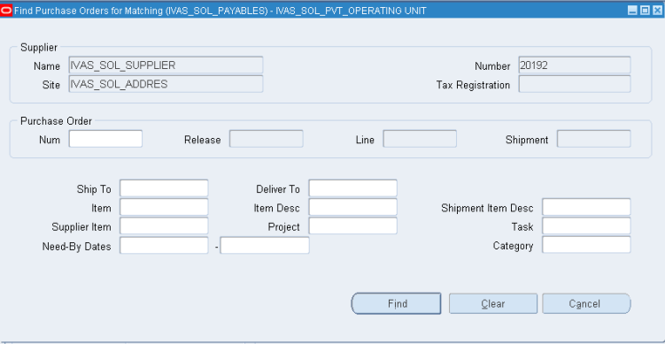
Select the purchase order number for which goods are returned

Slide 27
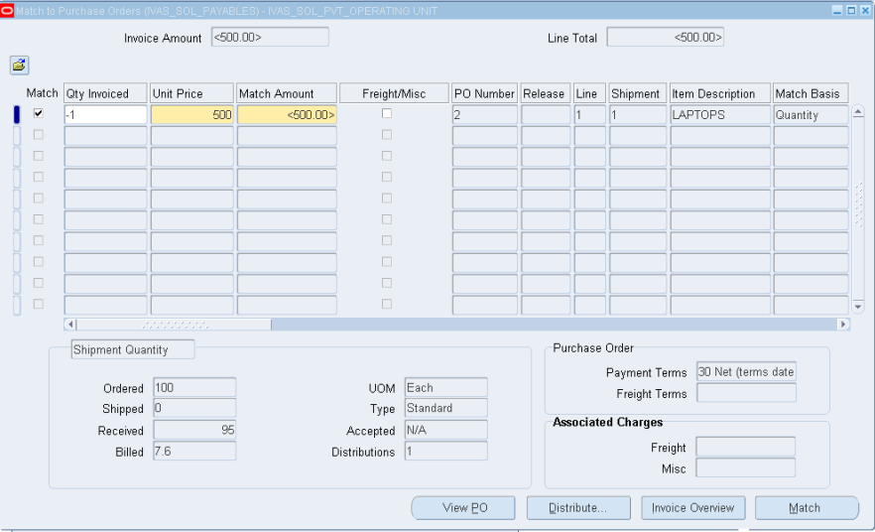
Enable match option and enter the Quantity invoiced in negative
Click in Match button

Slide 28
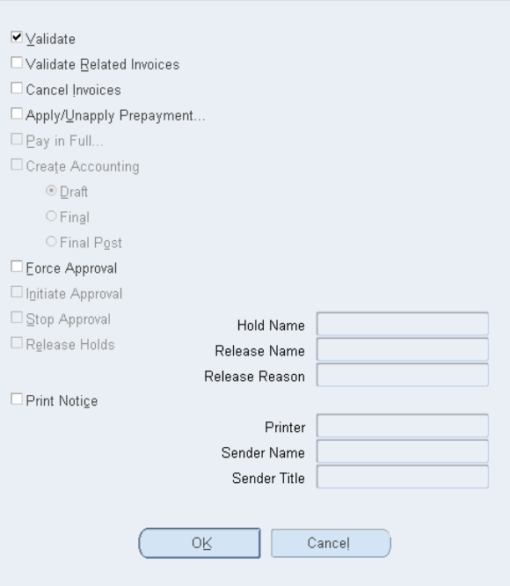
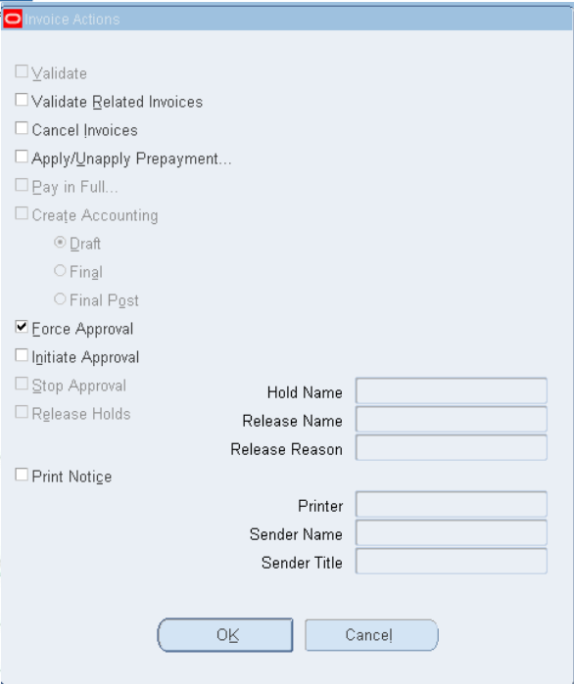
Click on Actions tab for Validate and Force Approval

Slide 29
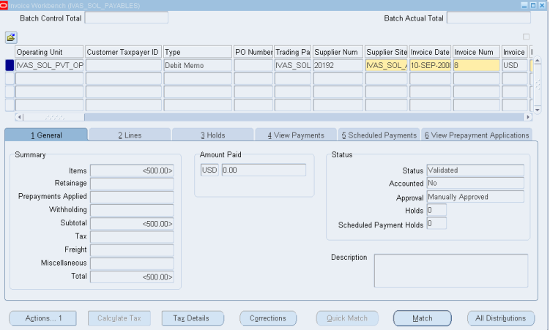
See the changes in Status:
Status as Validated and
Approval as Manually Approved

Slide 30
4. Mixed Invoice

Slide 31
In the "Type" field, select Standard Invoice.
Select the “Mixed Invoice" type.
Enter the Invoice Date and select the Supplier.
Input the invoice date and choose the supplier from the list.
Select the Invoice Currency.
Choose the currency for the invoice.
Enter the Invoice Number and Amount.
Input the invoice number and the total amount.
Click on the "Lines" section to enter item/service details (description, quantity, unit price).
Click on the "Lines" section to enter details of the goods or services (description, quantity, unit price).
Review the invoice for accuracy and click Validate.
Review the invoice for accuracy and click "Validate" to ensure correctness.
To post the accounting entry, navigate to Actions → Create Accounting.
To create the accounting entry, go to "Actions" and select "Create Accounting."

Slide 32
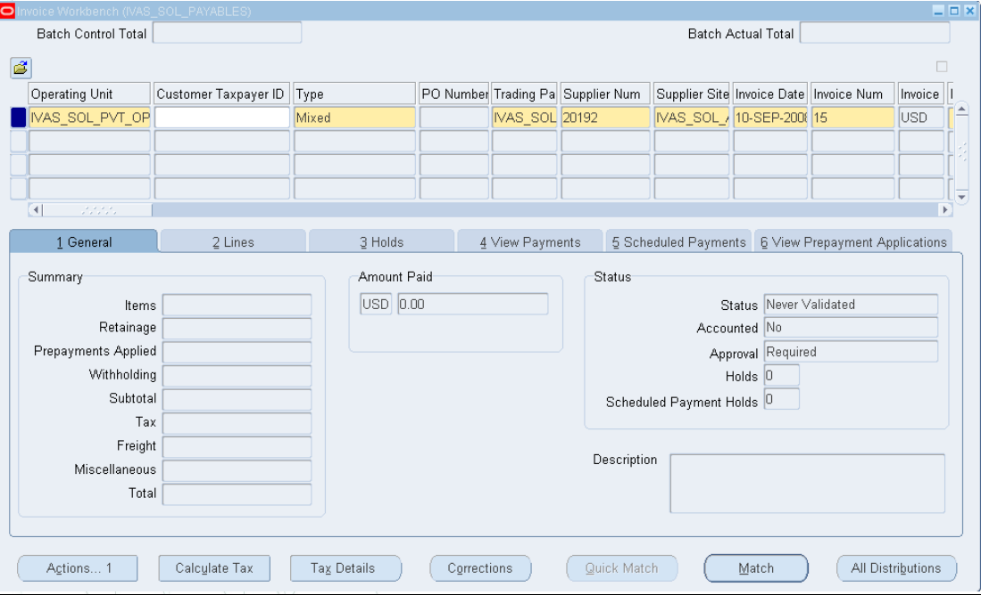
Click the Match Button

Slide 33
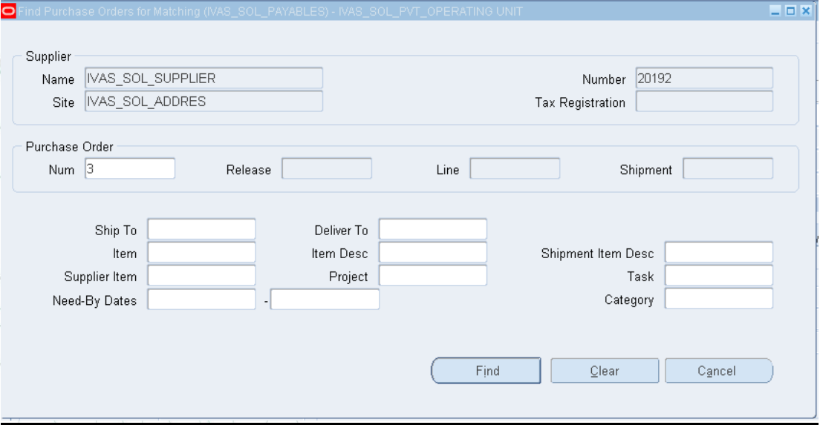
Click the find Button

Slide 34
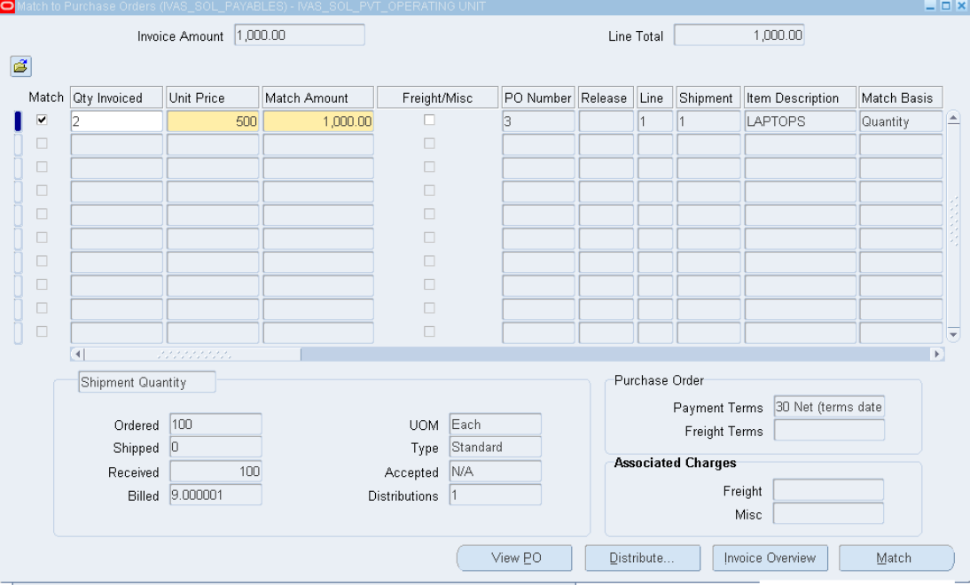
Enable match option and enter the Quantity invoiced in negative
.Click in Match button

Slide 35
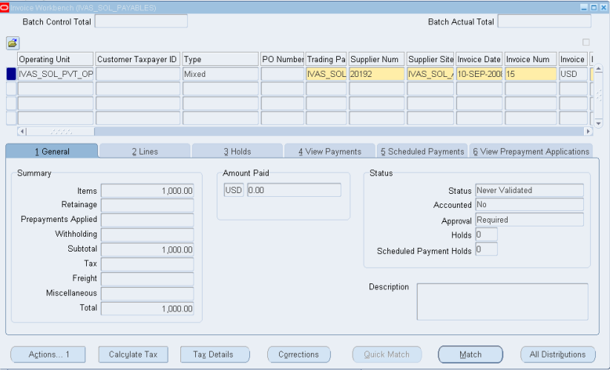

Slide 36
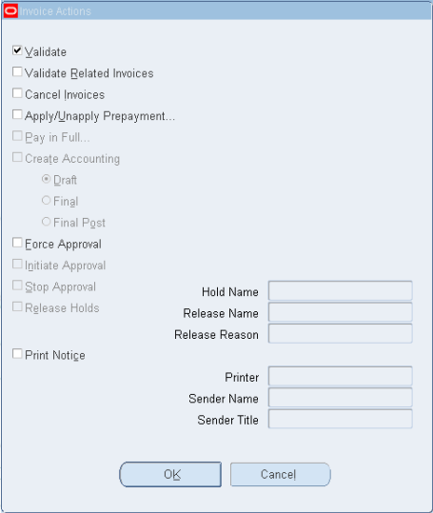

Click on Actions tab for Validate and Force Approval

Slide 37
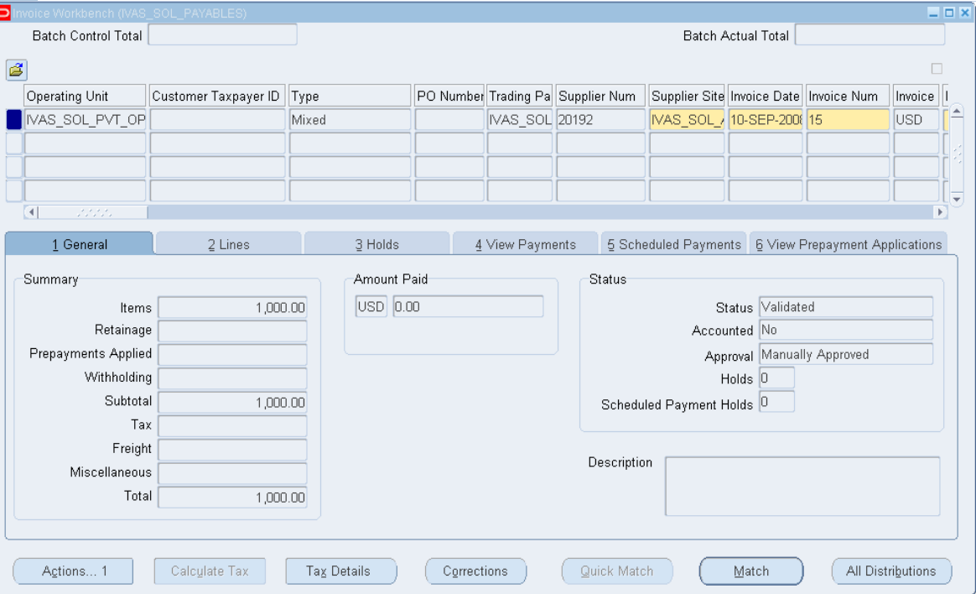
See the changes in Status
Status as Validated and
Approval as Manually Approved

Slide 38
5. Prepayment Invoice

Slide 39
In the "Type" field, select Standard Invoice.
Select the “Prepayment Invoice" type.
Enter the Invoice Date and select the Supplier.
Input the invoice date and choose the supplier from the list.
Select the Invoice Currency.
Choose the currency for the invoice.
Enter the Invoice Number and Amount.
Input the invoice number and the total amount.
Click on the "Lines" section to enter item/service details (description, quantity, unit price).
Click on the "Lines" section to enter details of the goods or services (description, quantity, unit price).
Review the invoice for accuracy and click Validate.
Review the invoice for accuracy and click "Validate" to ensure correctness.
To post the accounting entry, navigate to Actions → Create Accounting.
To create the accounting entry, go to "Actions" and select "Create Accounting."

Slide 40
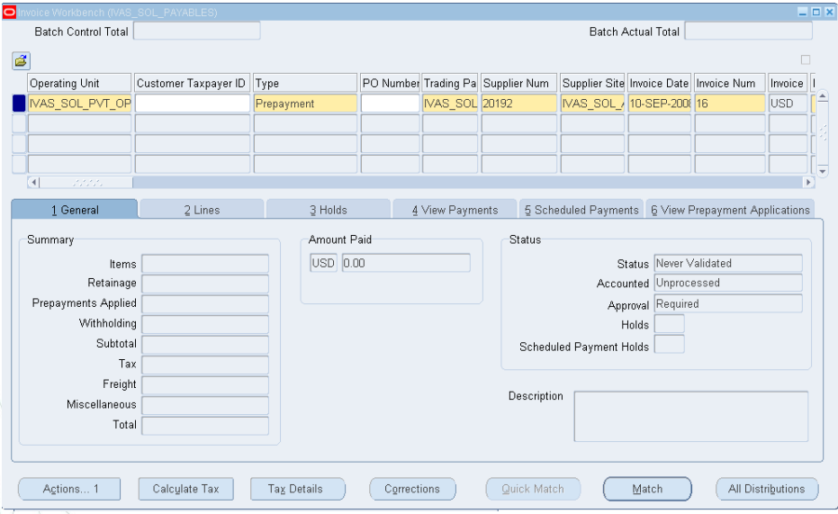
Un Validated
Save and Click Match Button then match with a Purchase Order

Slide 41
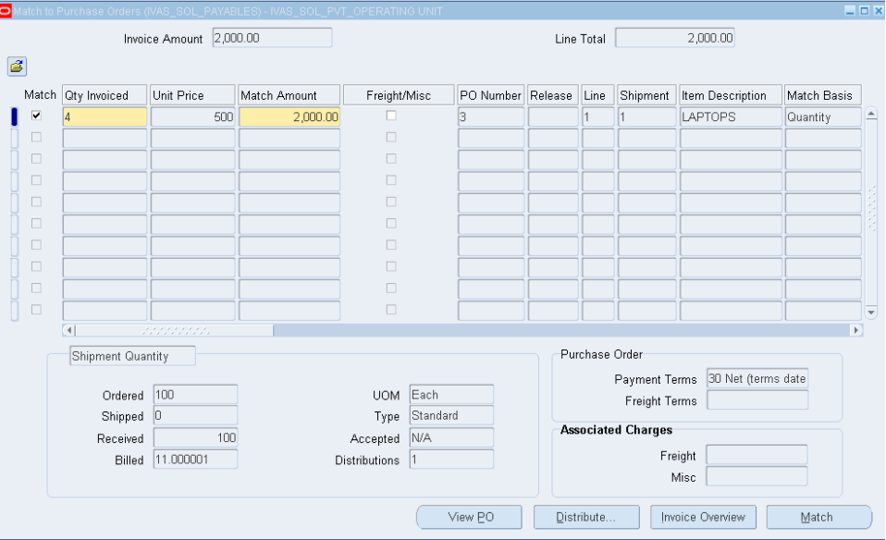
Click on Match button

Slide 42
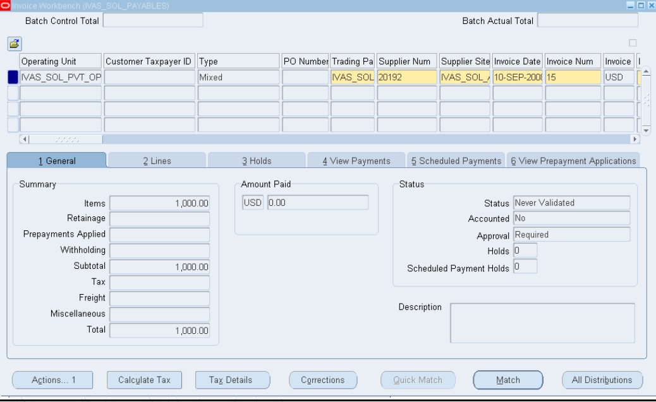
Click on Actions

Slide 43
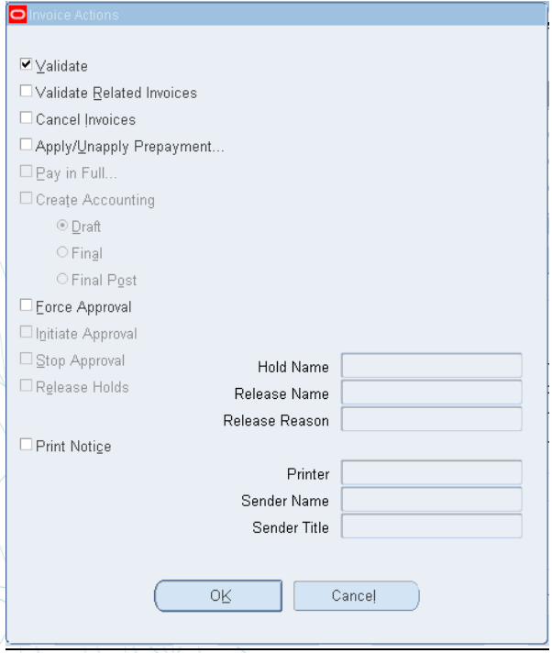
Tab for Validate

Slide 44
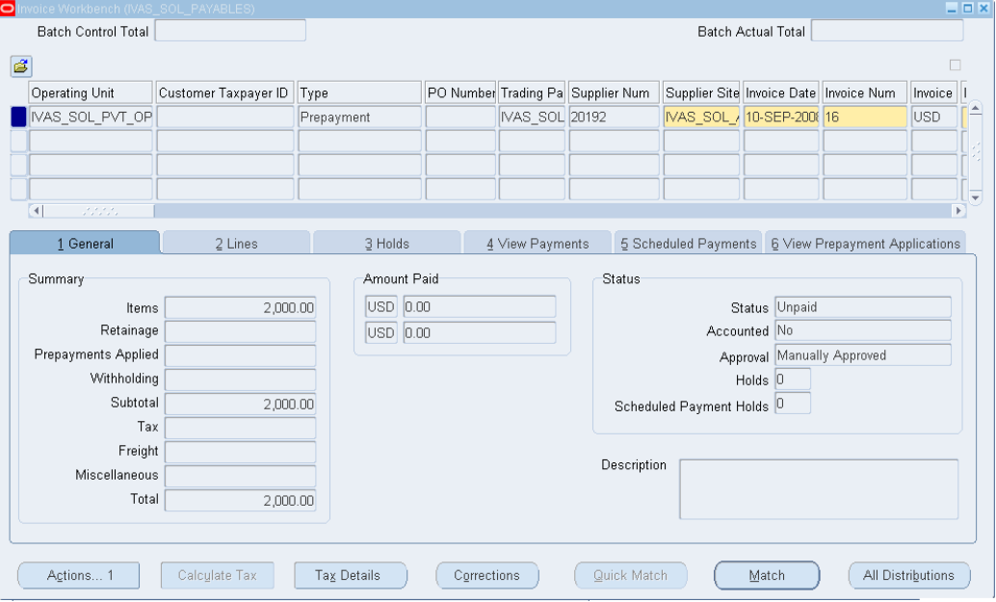
Click Action..1 Button again for creating Accounting

Slide 45
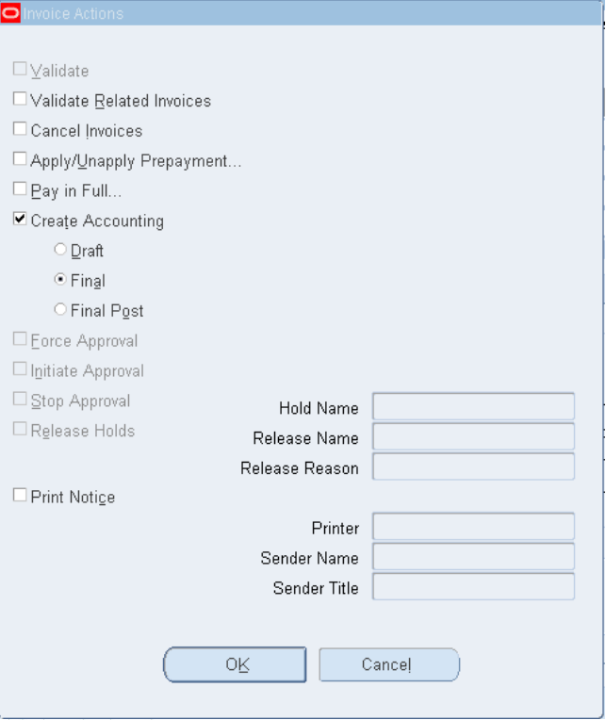
Click on OK Button and again Click on Action..1 Button in the previous form

Slide 46

Click on OK Button

Slide 47
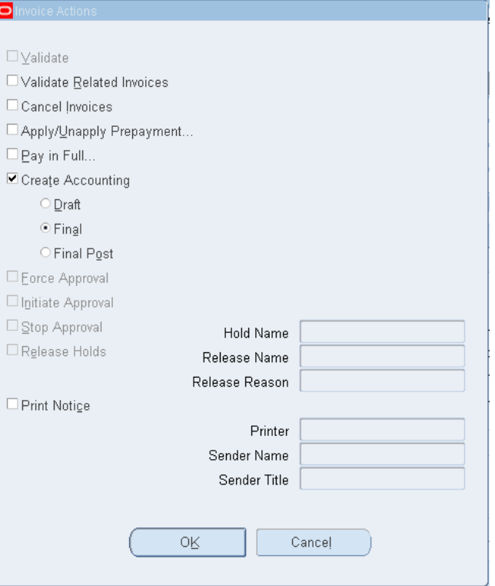
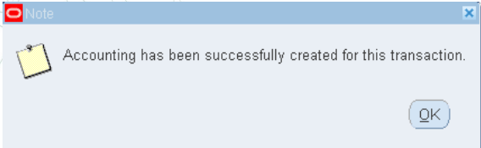
Click on OK Button

Slide 48
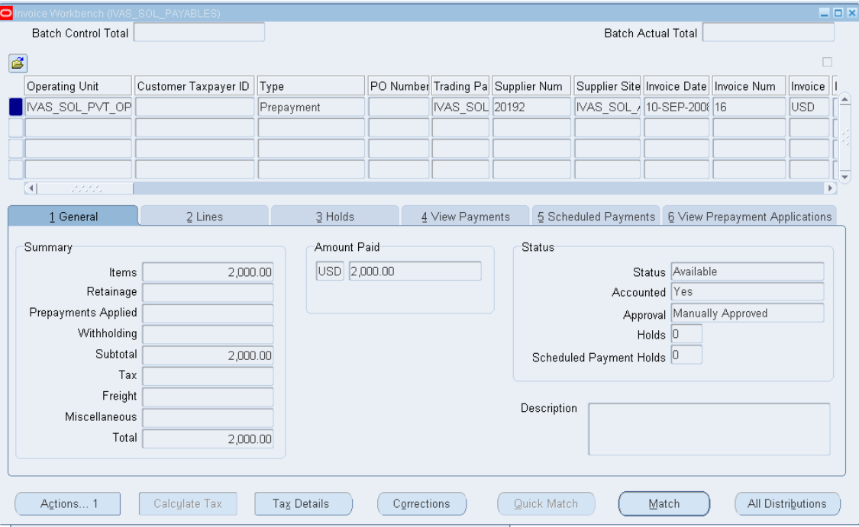
See the Status:
Its Available
Accounted yes
And manually approved

Slide 49
How to apply the Prepayment?

Slide 50
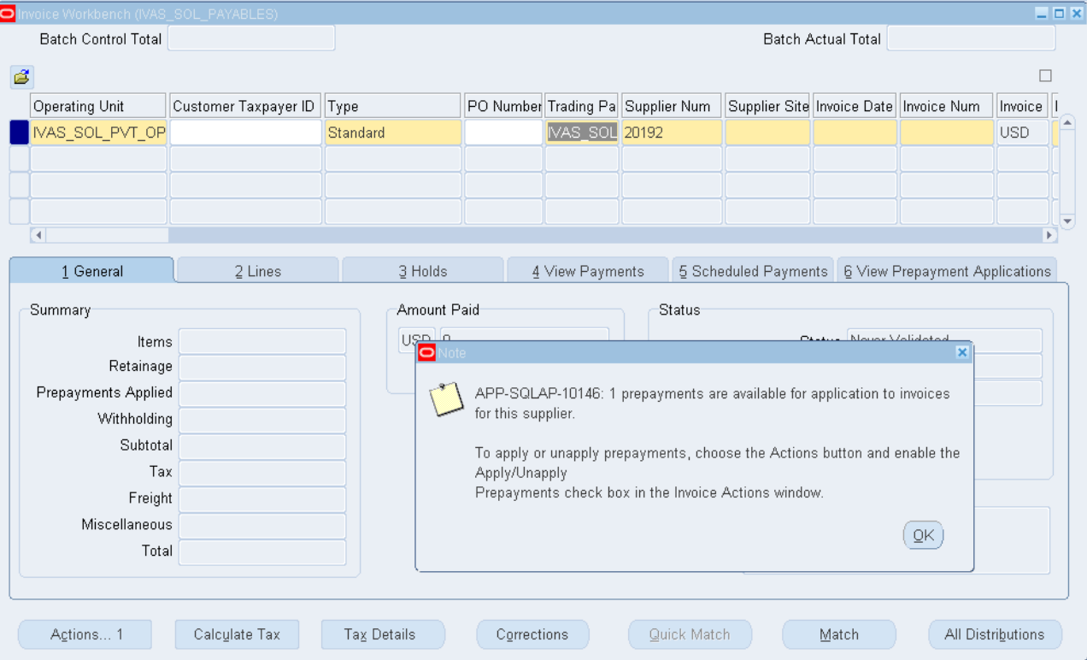
1- Create a invoice
When you create a new invoice you will get a Note saving that 1 prepayment is available

Slide 51
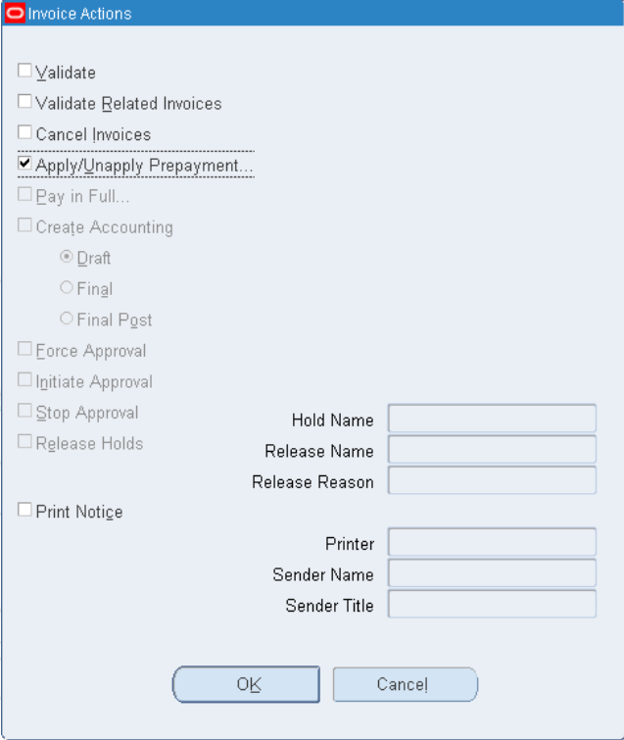
2- Match the invoice
3- Click on actions to Validate and Force approval then Creating Accounting
4- Now click on Actions select Apply/ Unapply Prepayment
Click on OK button

Slide 52
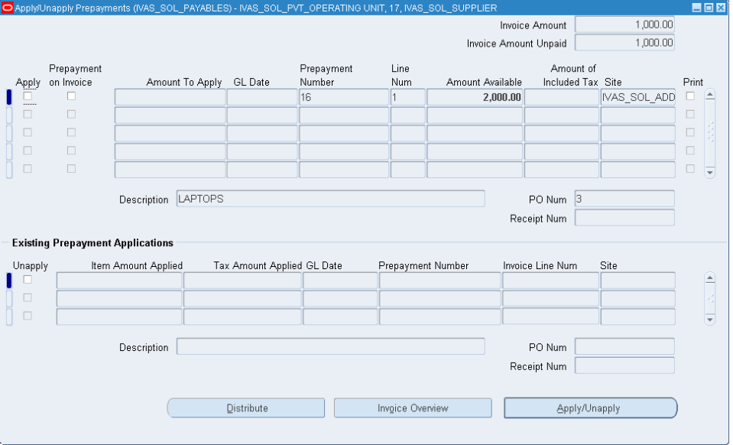
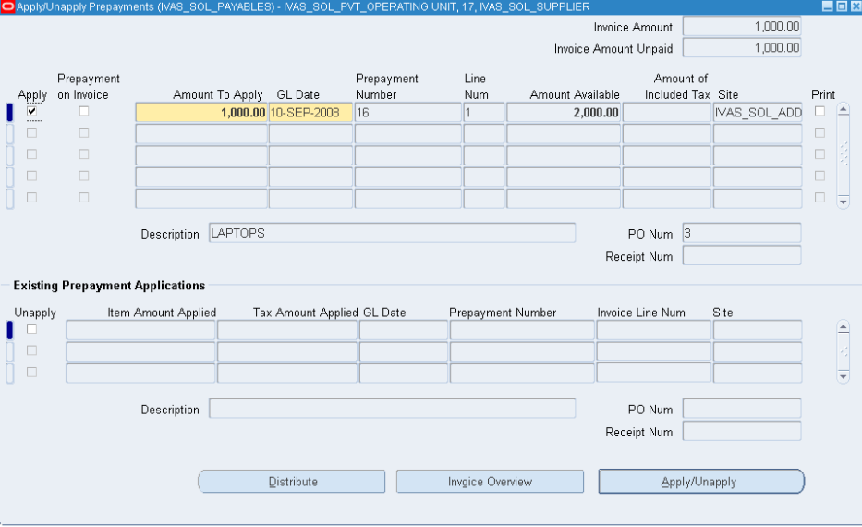
Click on Apply
Click on Apply/ Unapply Prepayment button

Slide 53
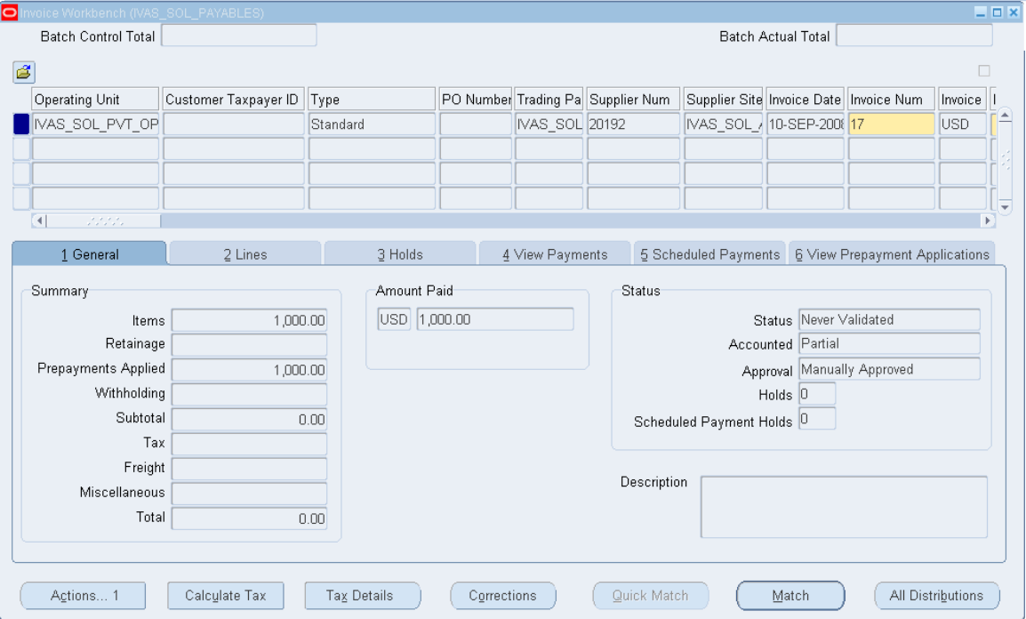
Check the Amount Paid Status
Then Back to make accounting and validation again

Slide 54
Canceling Invoice

Slide 55
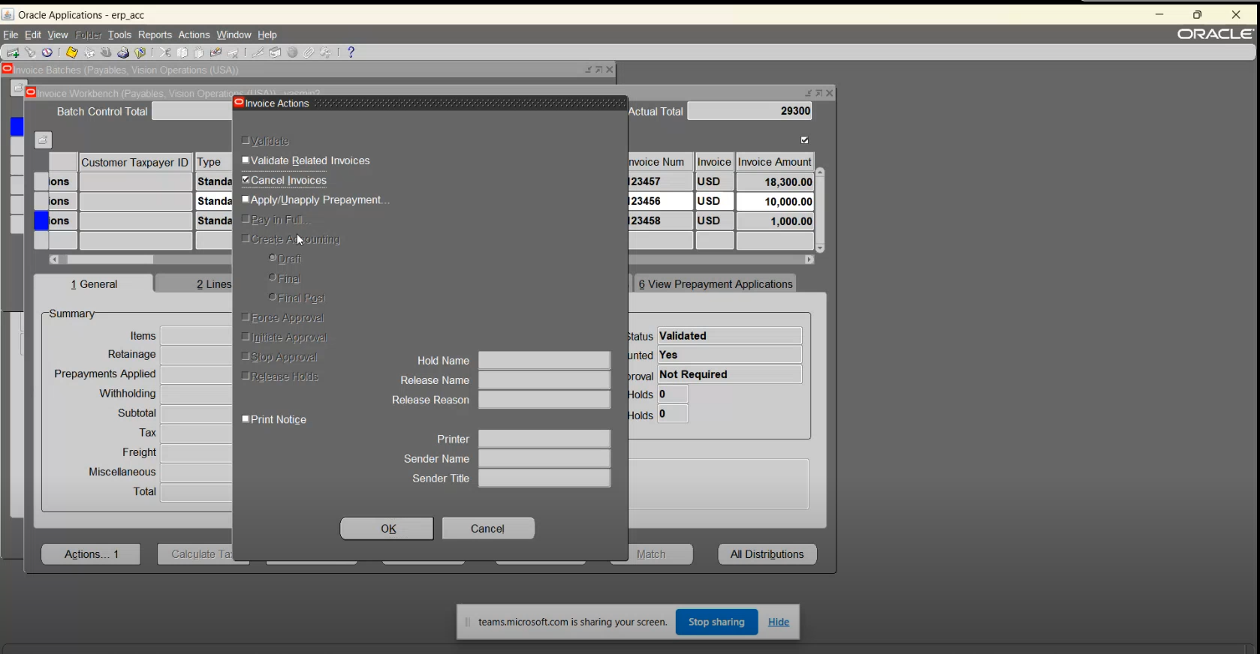
Choose invoice that you need to cancel
Then move to action , and choose Cancel invoice

Slide 56
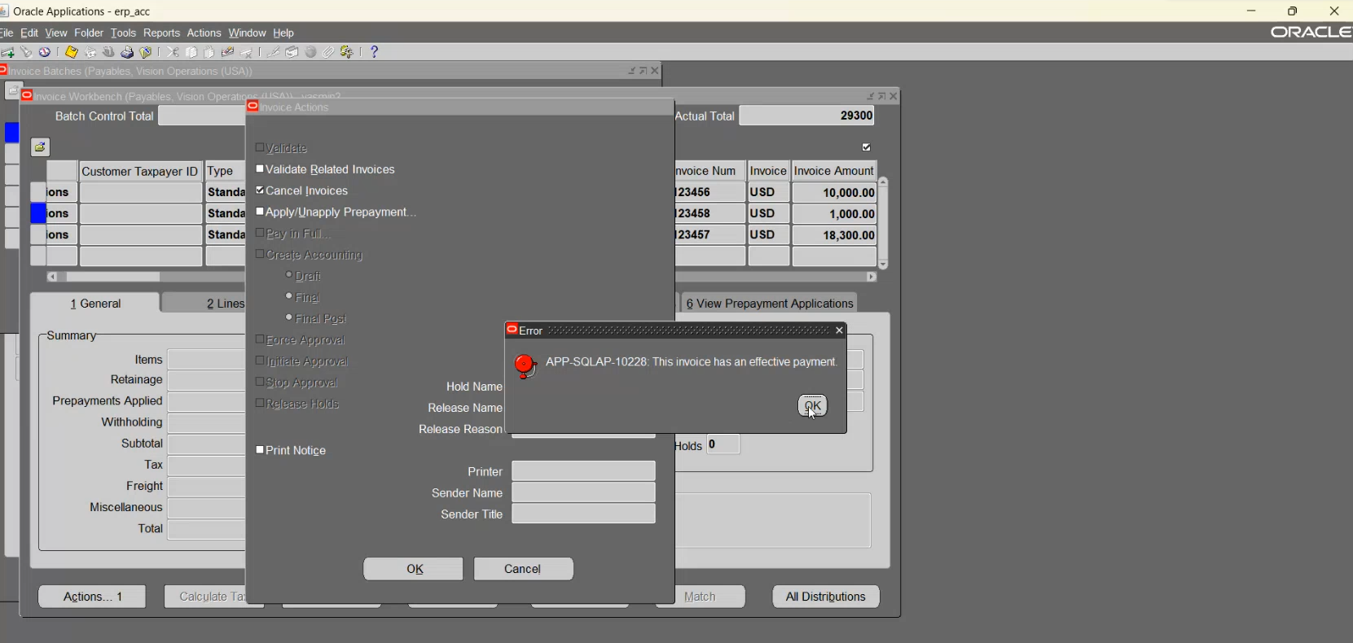

Slide 57
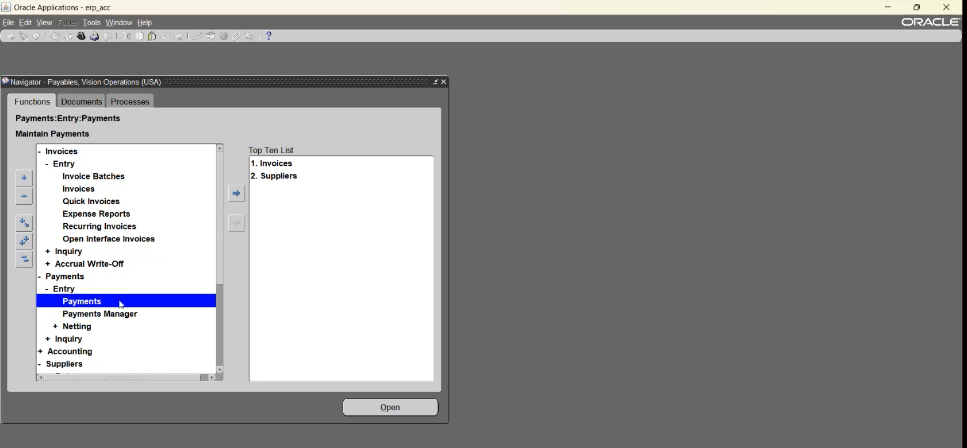
N:Payments > Entry > Payments

Slide 58
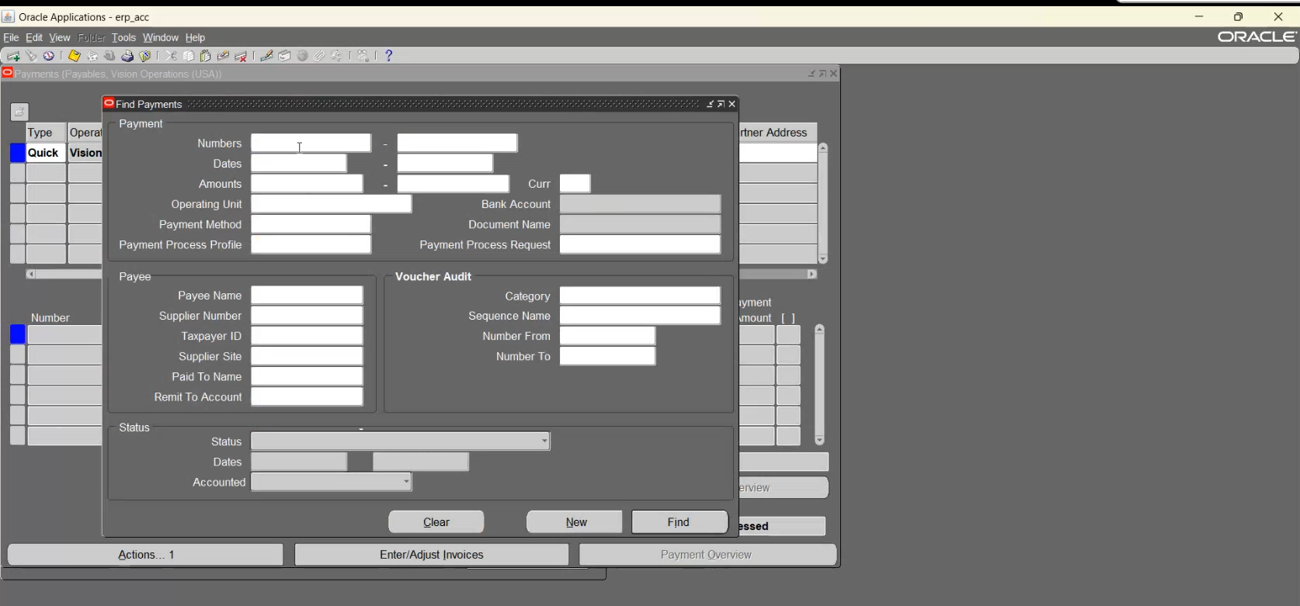
Put the invoice number
Click find

Slide 59
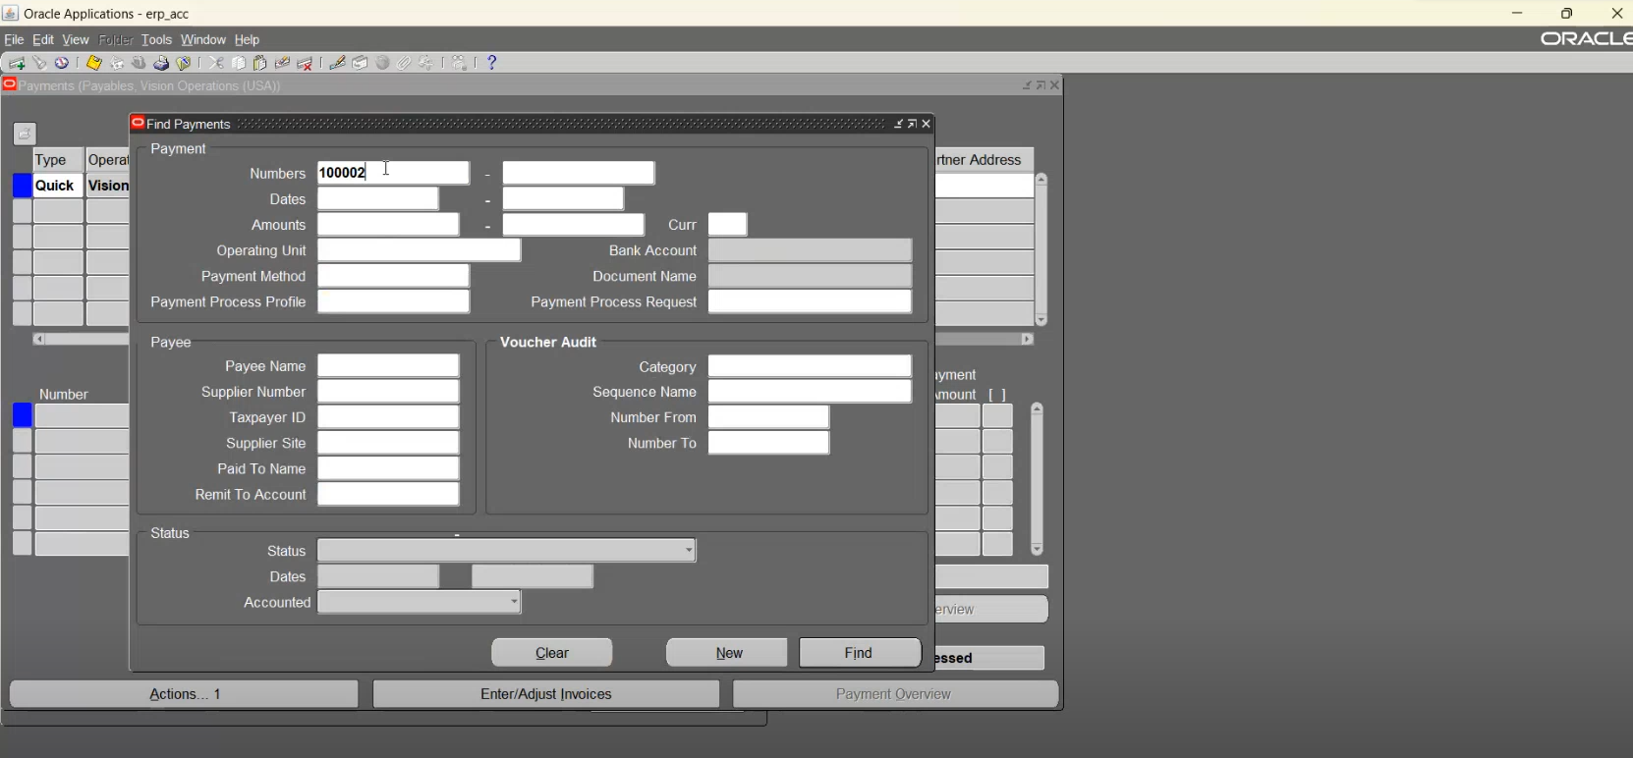

Slide 60
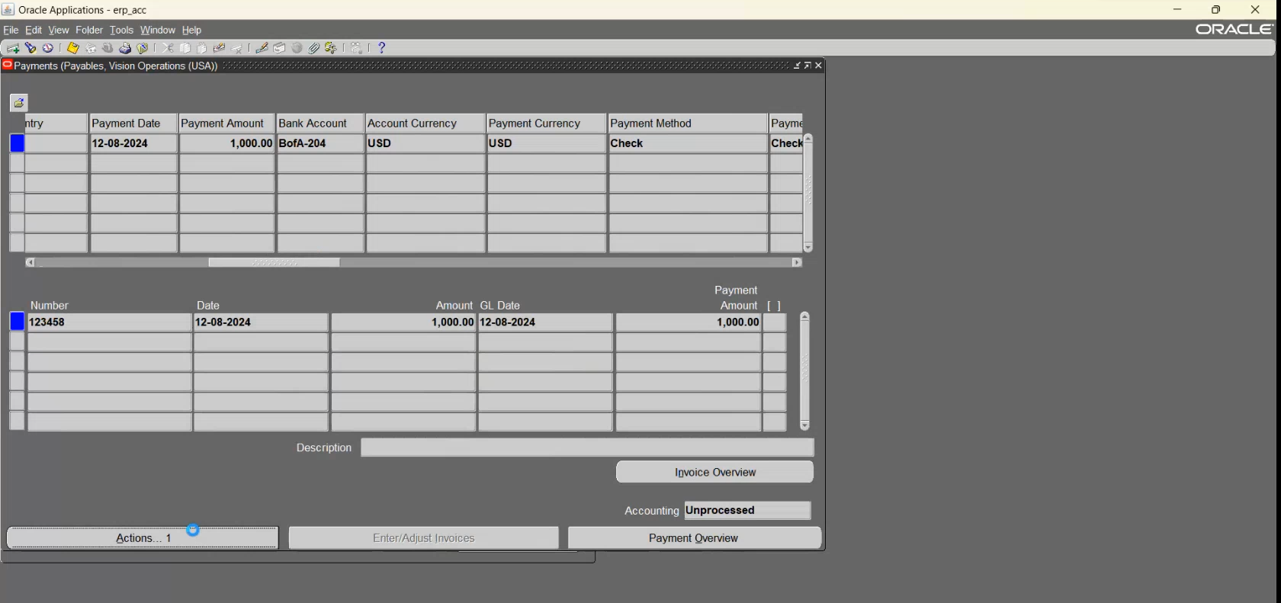
This is the data of the invoice

Slide 61


Click avoid then choose cancel

Slide 62

The transaction has been Reversed

Slide 63

See the status:
Its cancelled and the accounting is partial
Click action bottom

Slide 64

Choose create accounting

Slide 65

See the status now:
Its Canceled and the
Accounting status is Yes

Slide 66

To see transaction: choose Tools > View accounting events

Slide 67

Creating invoice
Canceled invoice
Click view journal Entries

Slide 68

This is the natural transaction of creating invoice

Slide 69

You can see the transaction has been Reversed

Slide 70




My Contact
aahmedmabrouk165@gmail.com
01004504896
Cairo-Nasr city
linkedin.com/in/ahmed-el-rubai-22406b277
Feel free to message me

